Slide 1
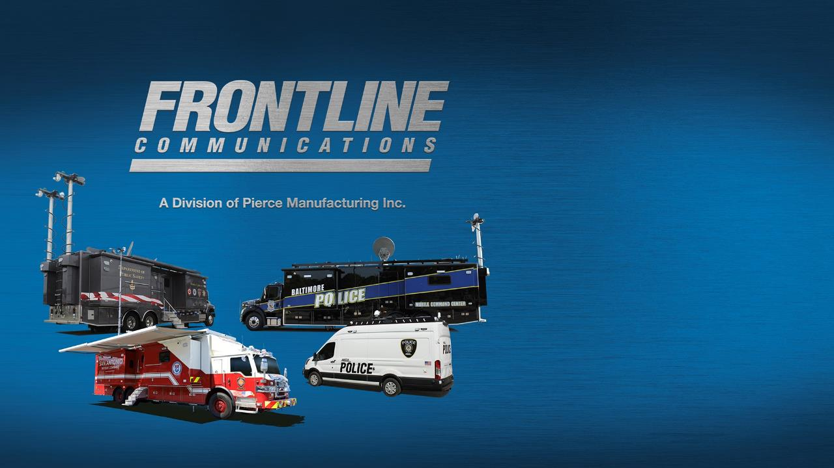

Salt Lake City Fire Department
C-32X-2
Mobile Command Unit Features

Slide 2
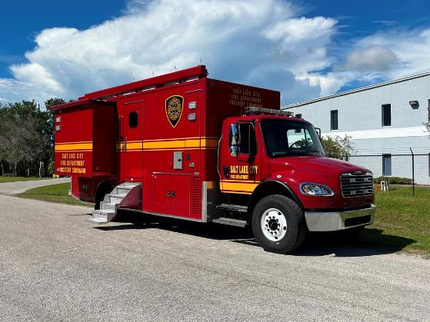
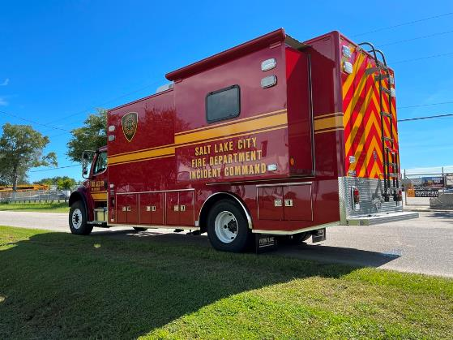
Overall Length: 32’ Overall Height: 12’-10.6”
GVWR 33,000 lbs.

Slide 3
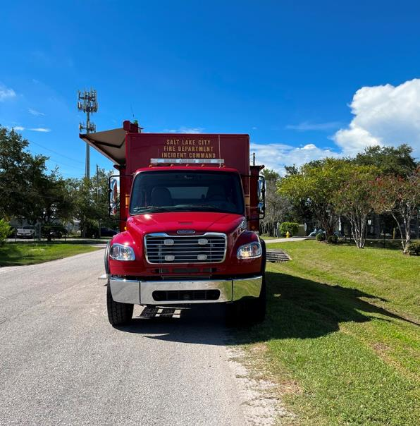
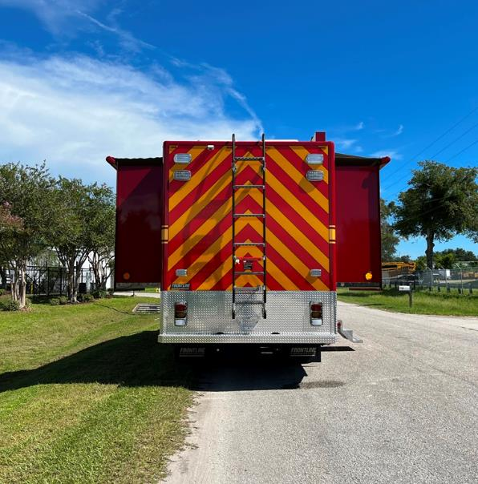
Freightliner M2-106 Chassis, Whelen light package,
18’ Electric awning
(2) 8-ft slide-out sections in conference area, Zico ladder,
Sharpvision color back-up camera system

Slide 4
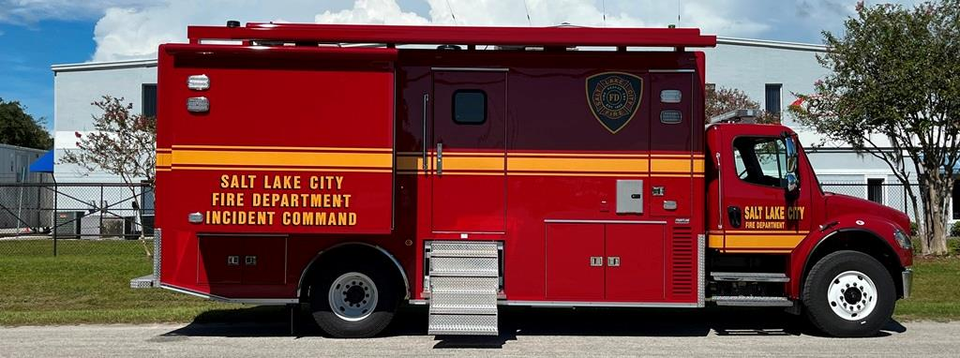

LED underbody perimeter lights, (4) “Big Foot” hydraulic jacks, (4) Rooftop air conditioners, NFPA step surfaces

Slide 5
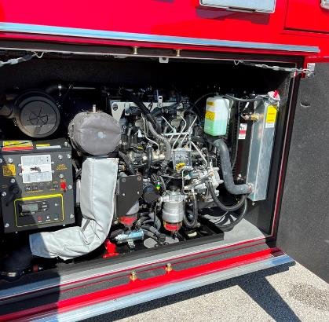
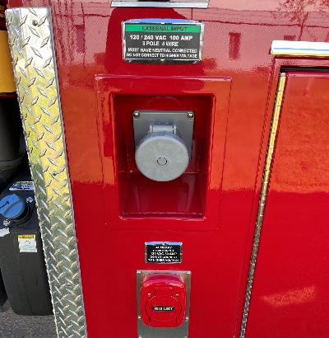
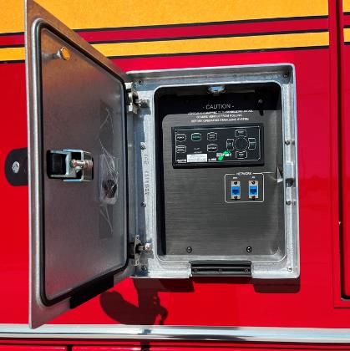

20kW Powertech generator in triple-insulated compartment
100A Shore power upgrade
Exterior panel with jack controls and network connections

Slide 6
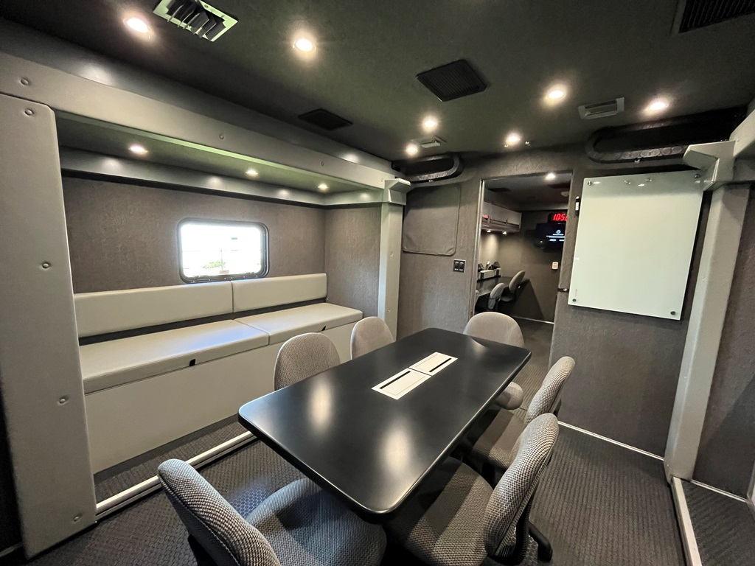
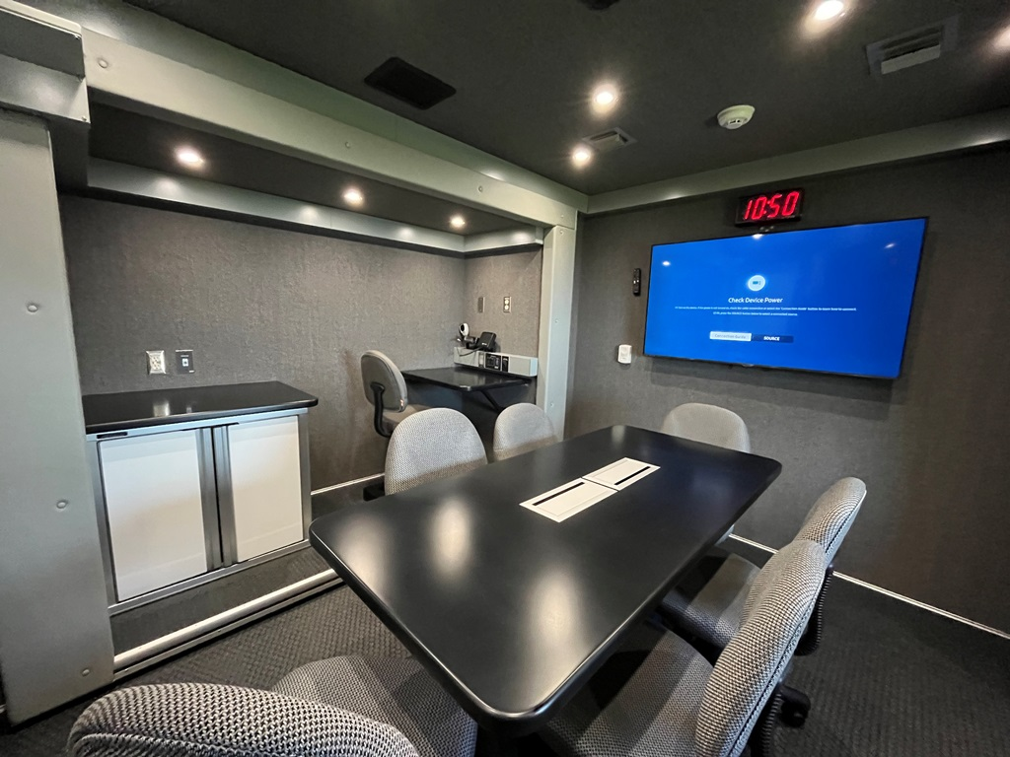
Conference Room features:
Six-person conference table with recessed power and network connections
One workstation with video switcher/data/power connections and storage cabinet in the curb side slide-out
Bench seating with under-cushion storage and a 20x30 emergency egress window in the street side slide-out
Solid surface countertops
55” display
24” x 36” magnetic whiteboard
Locking pocket door for privacy

Slide 7
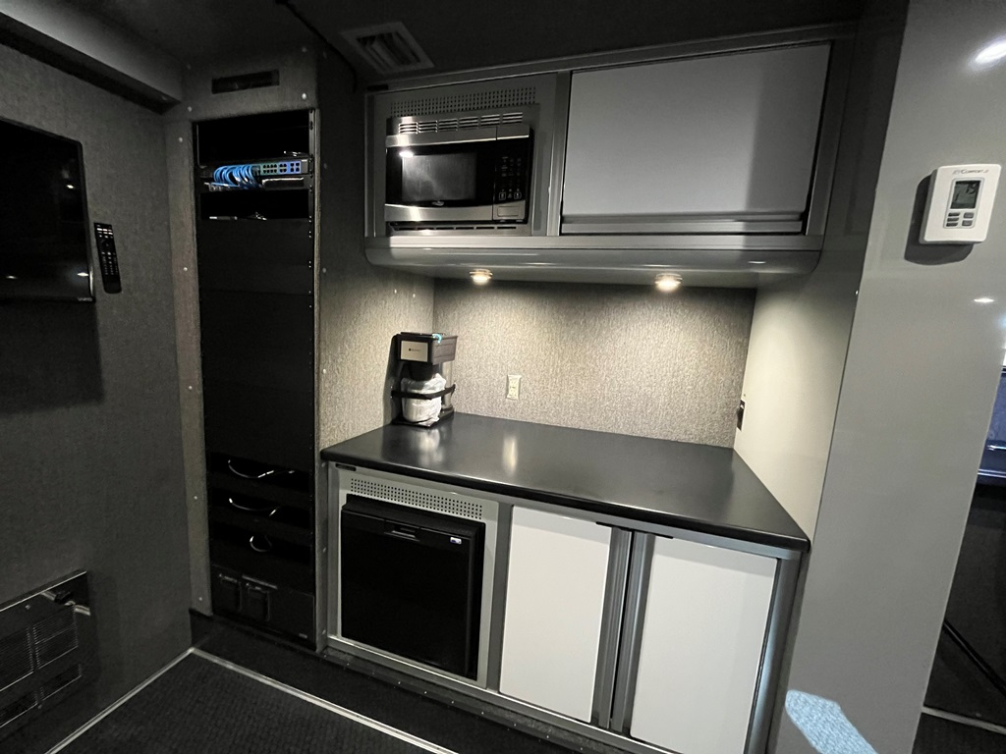
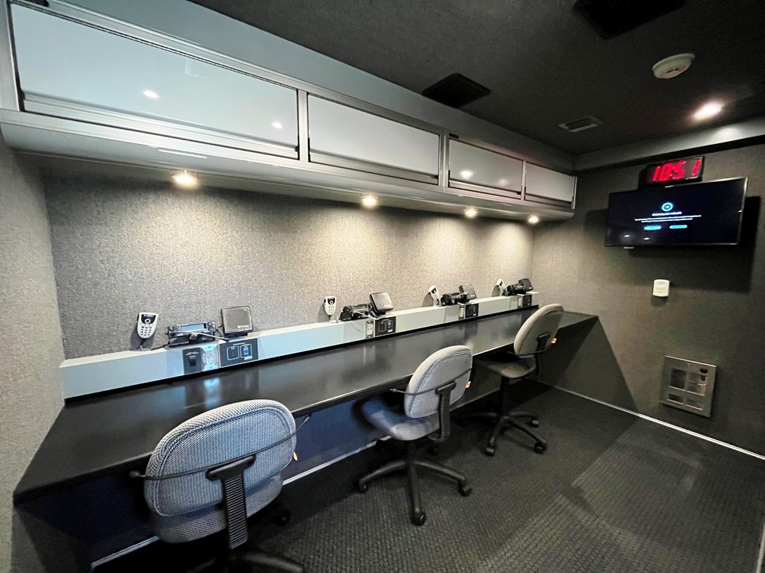
Operations Area features:
Four workstations each with mounted radios and connection panels for video and network
Galley: Refrigerator, microwave, and coffeemaker
Full-height equipment rack with exterior rack access and LED ligthing
32” display
Solid surface countertops and custom aluminum storage cabinets

Slide 8
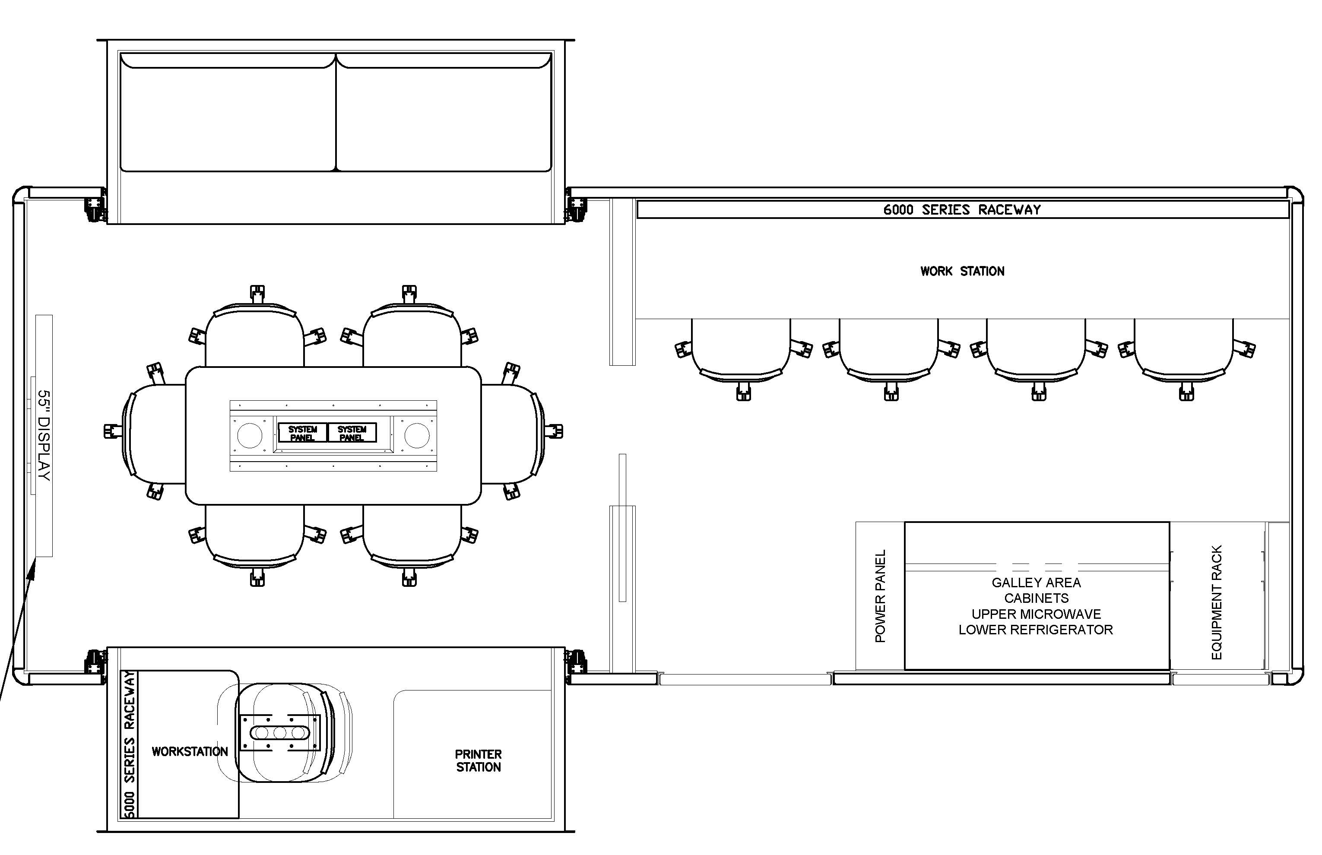

Slide 9
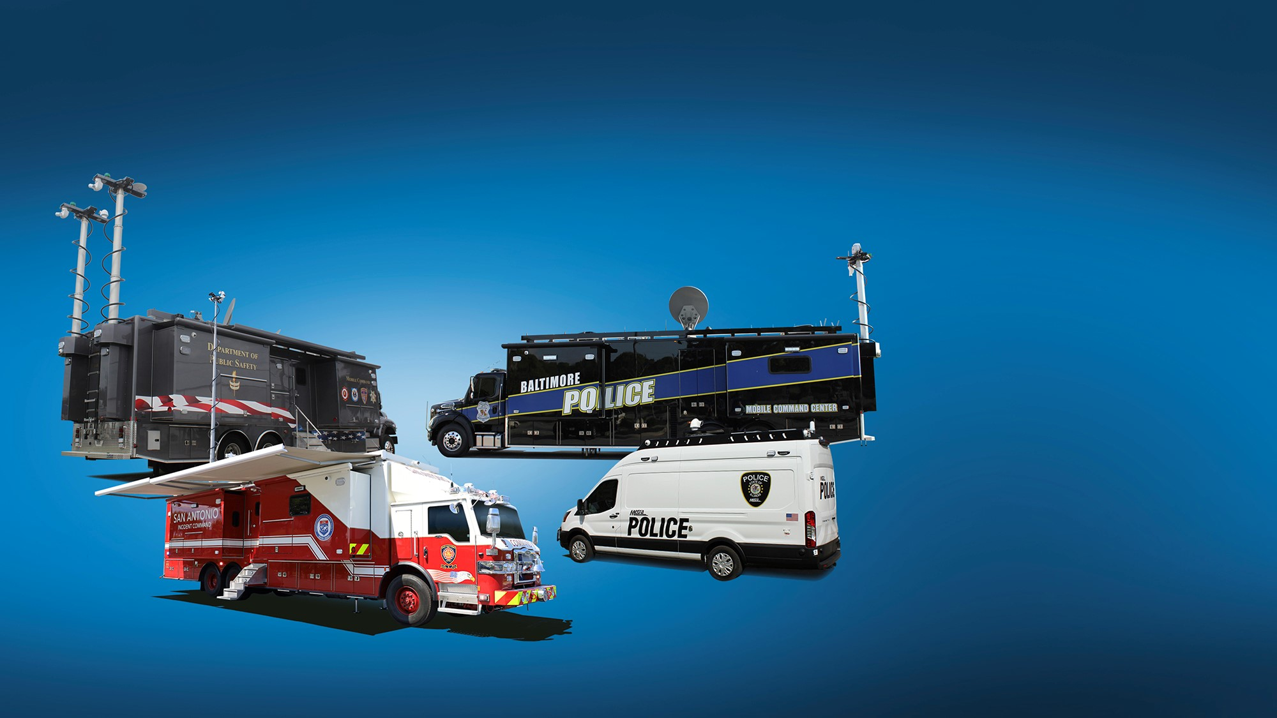
For more information on Salt Lake City Fire Department’s
C-32X-2 Mobile Command Unit
please contact your Frontline Communications RVP.

