Slide 1

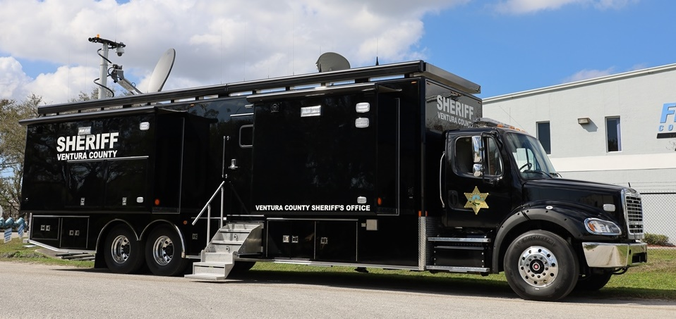
Ventura County Sheriff’s Office
C-45X-4
Vehicle Presentation
For best results, please view in
Slide Show Mode

Slide 2
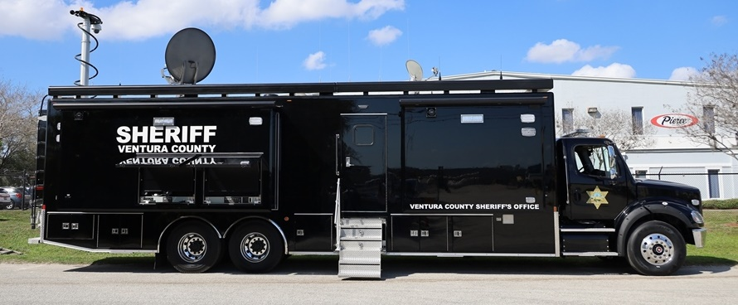
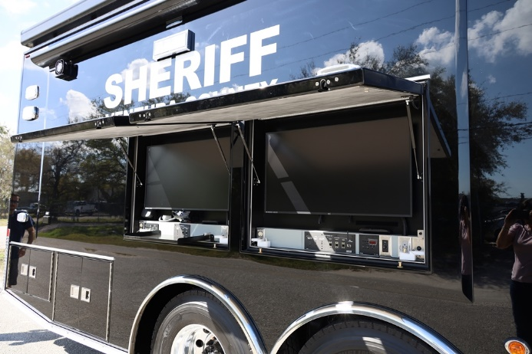
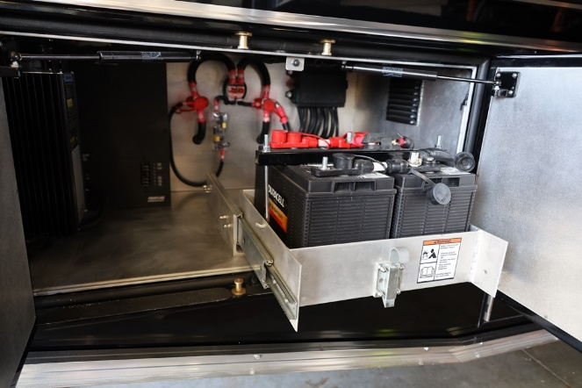
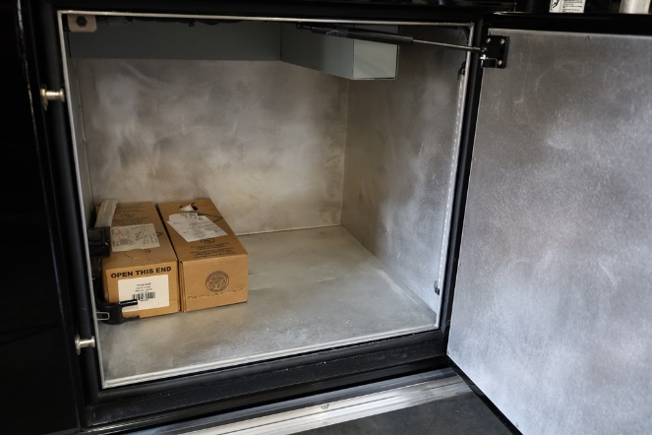
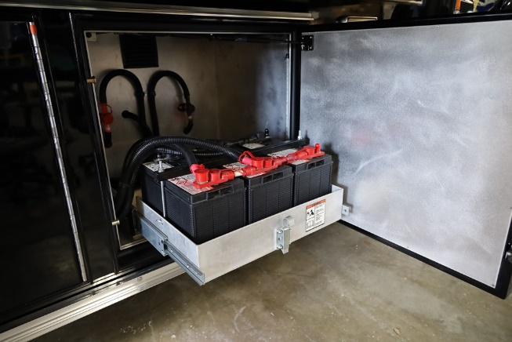
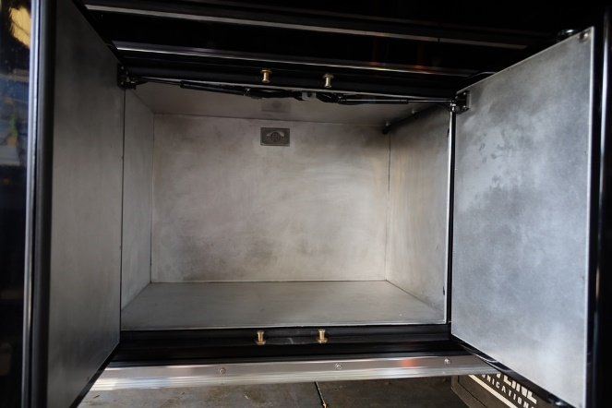
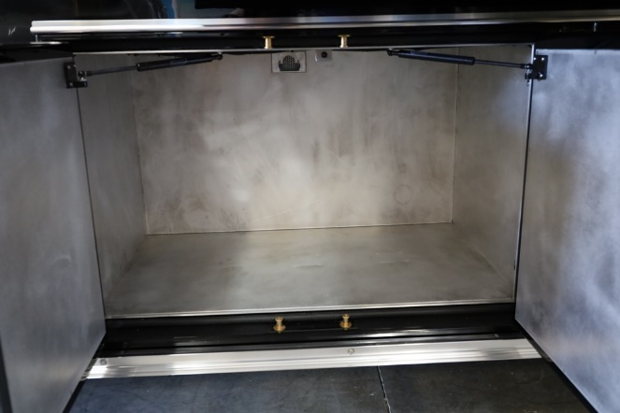
Curbside Body Compartments

Slide 3
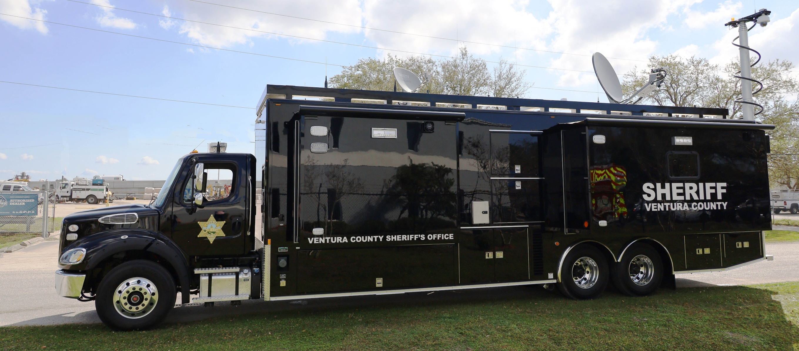
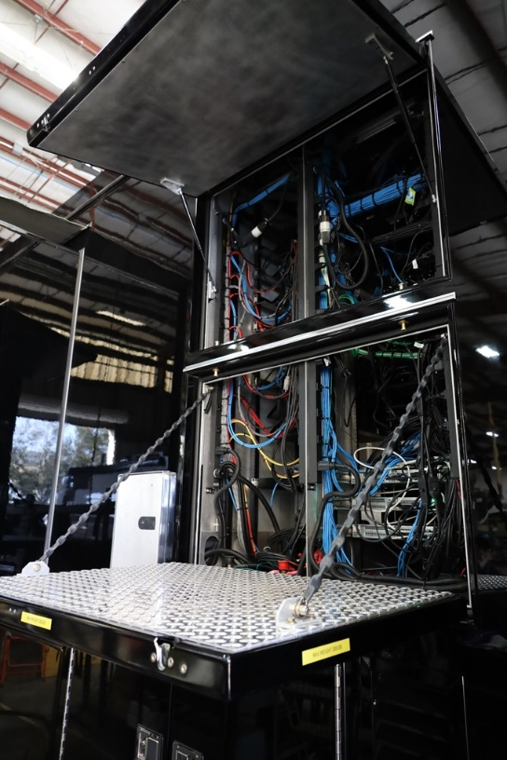
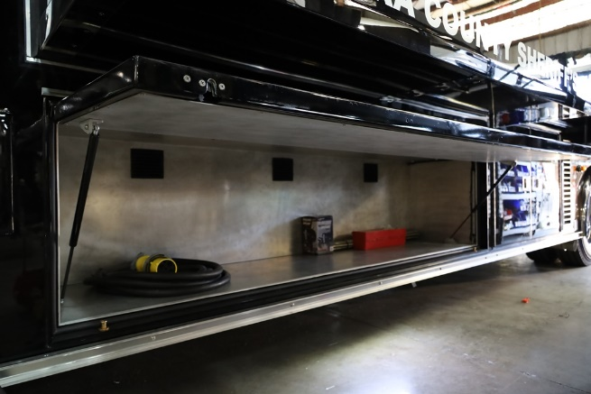
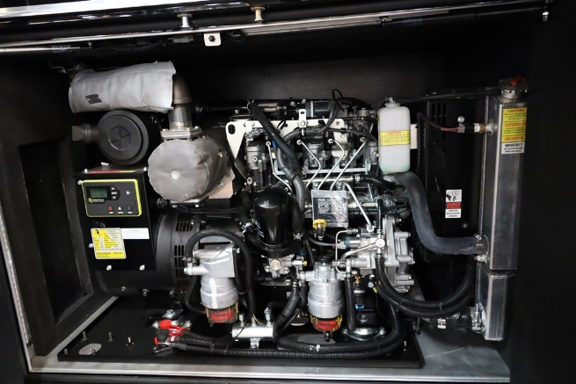
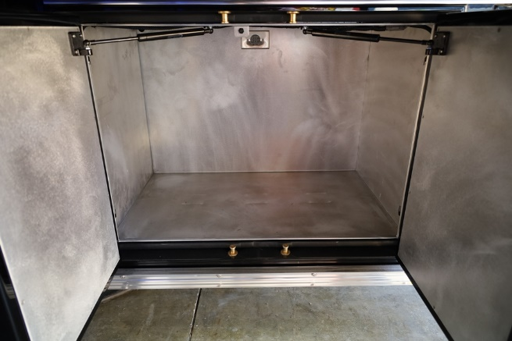
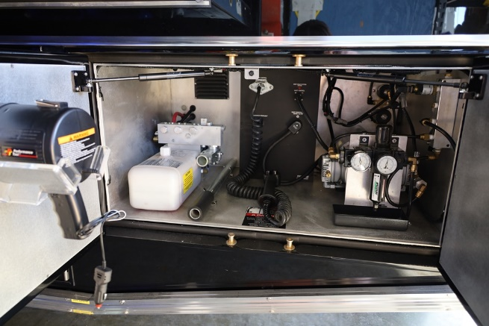
Streetside Body Compartments

Slide 4
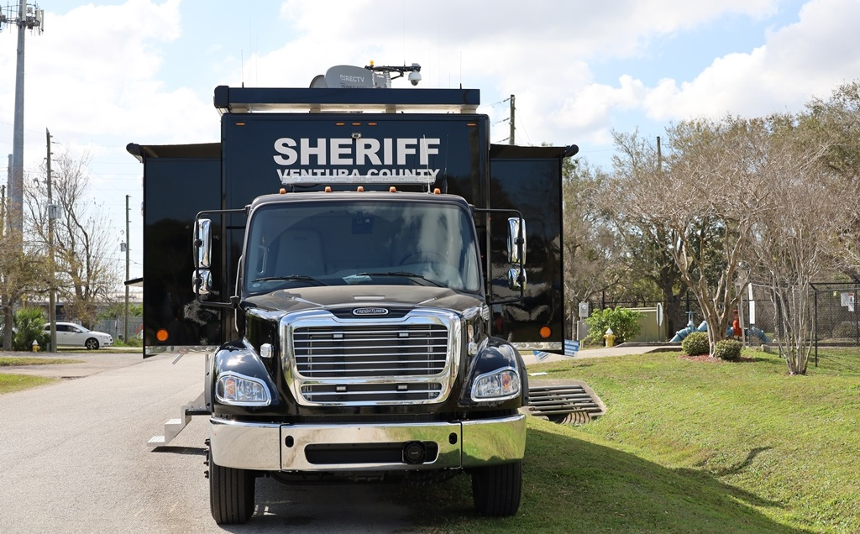
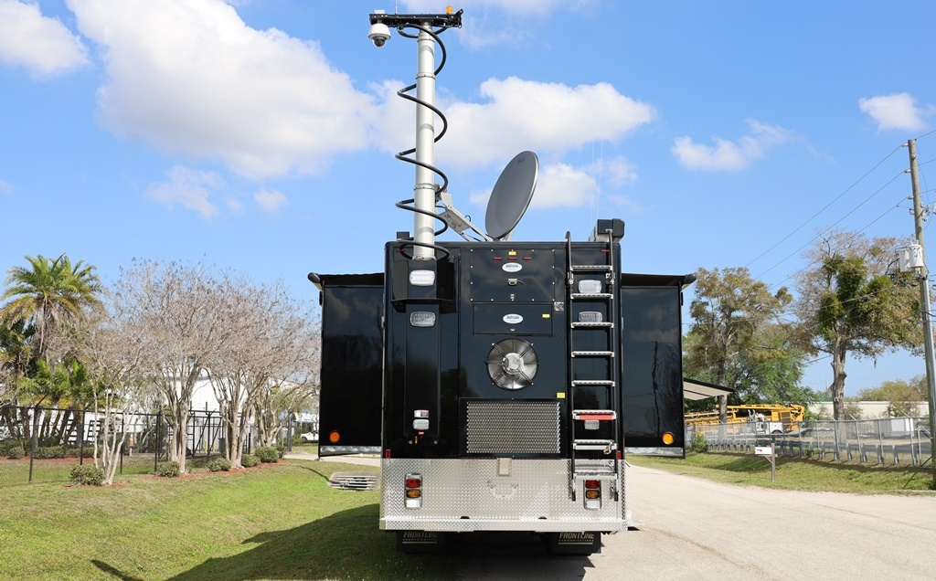
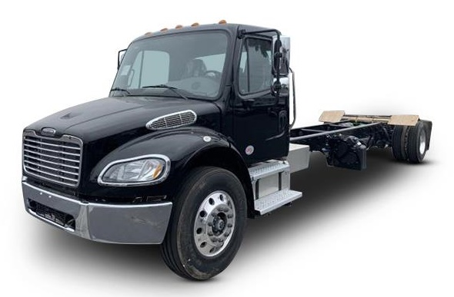
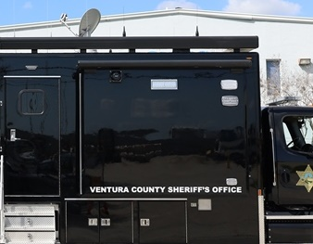
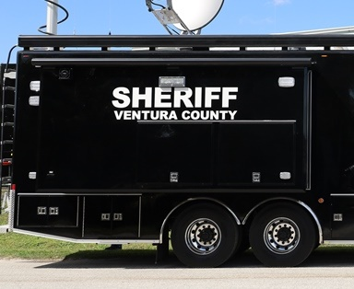
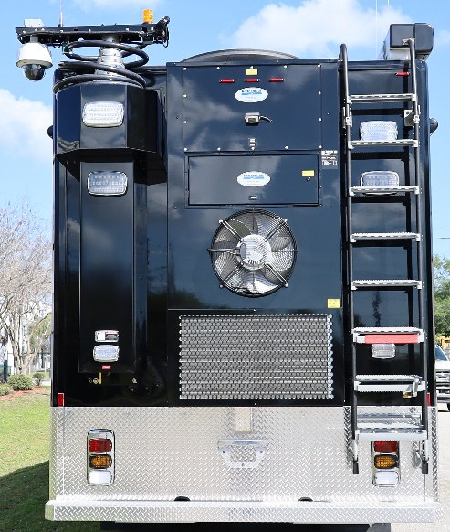
Integral Vehicle Options
Freightliner M2-112 chassis includes (2) 50-gal. fuel tanks
(2) Small (< 8’) slide-outs in forward operations area
(2) Large (12’-18’) slide-outs in rear conference area
4-ton ECU, 42’ mast, Zico ladder

Slide 5
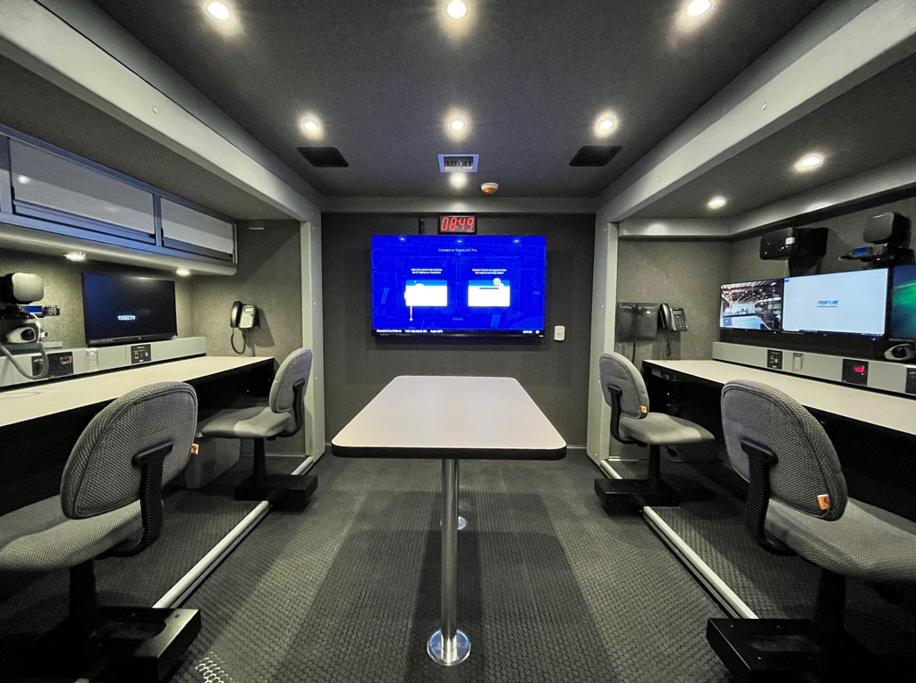
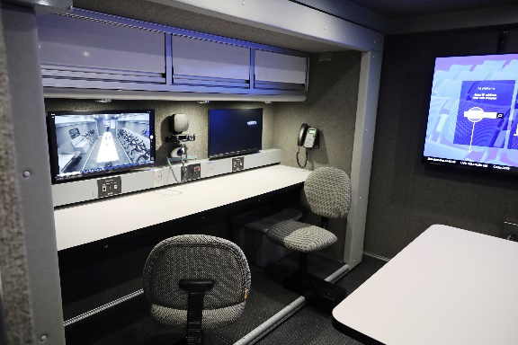
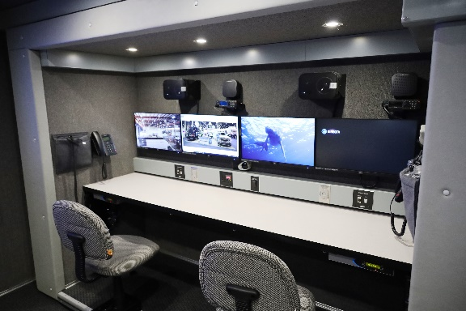
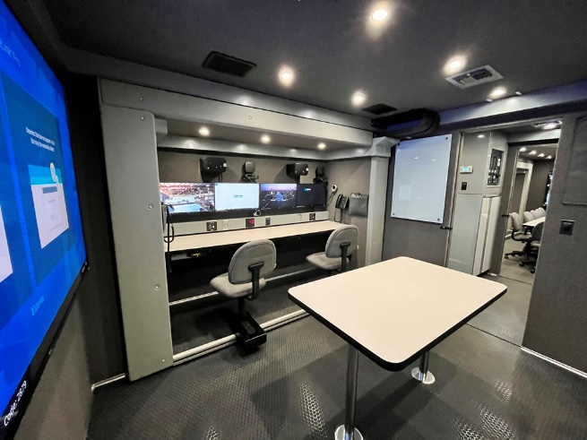
Forward Operations Area
Operations area features (4) workstations with PCs, sliding swivel pedestal seats, (6) monitors, and input/output panels with walk-up laptop connections and network inputs. We installed VCSO’s radios, speakers for their PA system, and phones for video teleconferencing.
Additional features are overhead C-Tech storage cabinets, removeable conference table, glass dry erase board, and a 70” touchscreen monitor with screen-sharing technology.

Slide 6
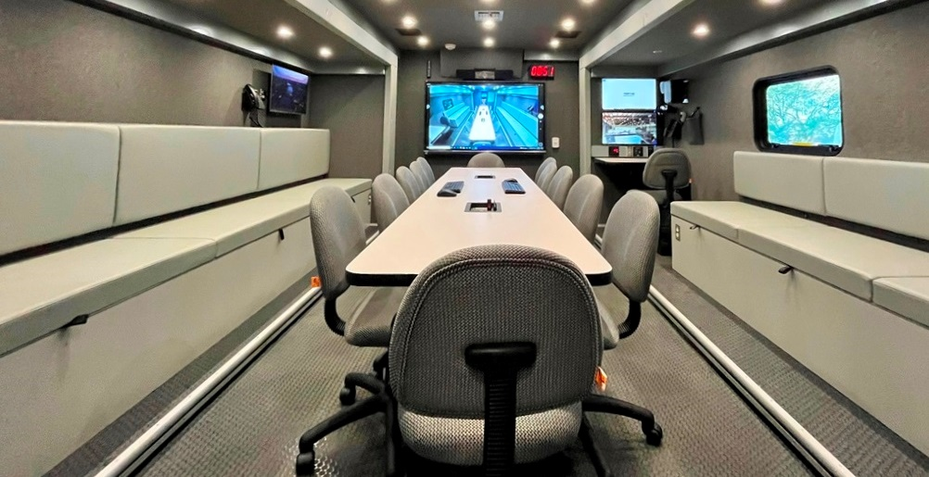
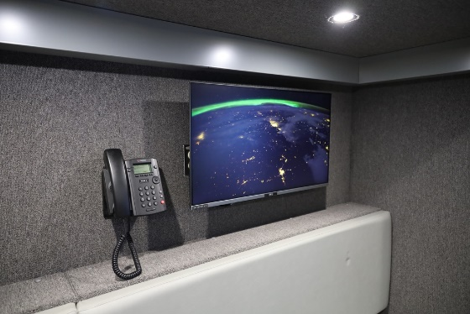
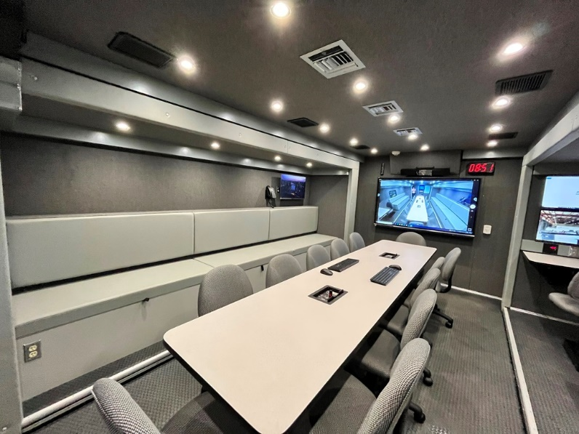
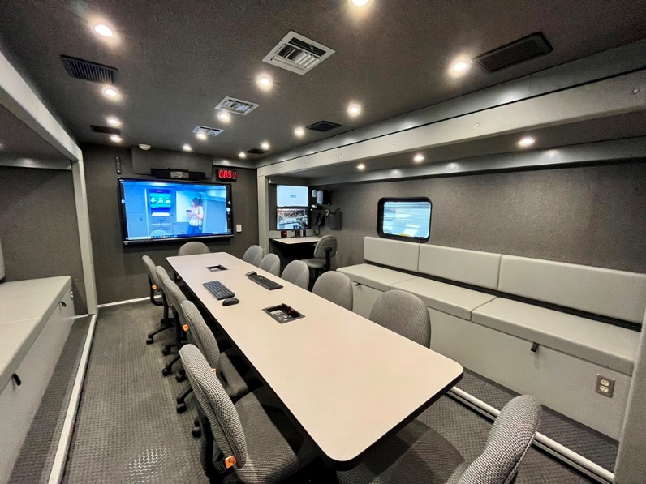
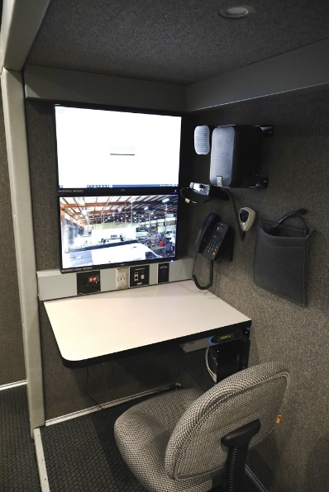
Rear Conference Area
The extra-large conference area features (2) large slide-outs with ample bench seating and under-cushion storage. The conference table has seating for twelve and (2) recessed power and data inputs.
A 70” touchscreen monitor, videoconference camera, speakers, and a digital clock are mounted on the back wall.
The curbside slide-out features an area set aside for in and outbound calls
The streetside slide-out features a Scribe station that doubles as radio dispatch.

Slide 7
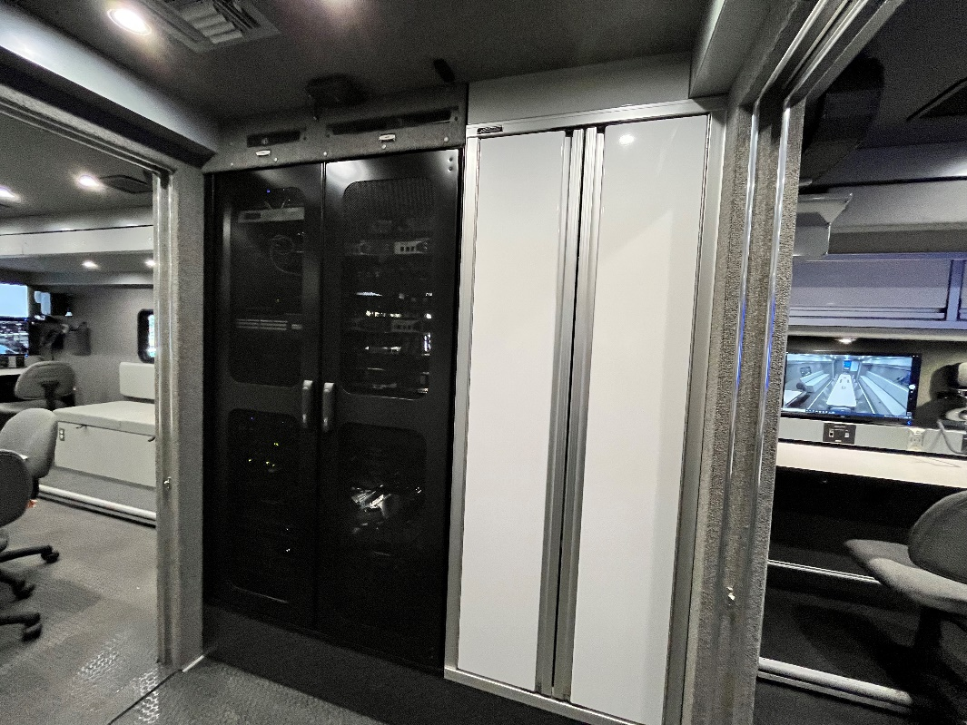
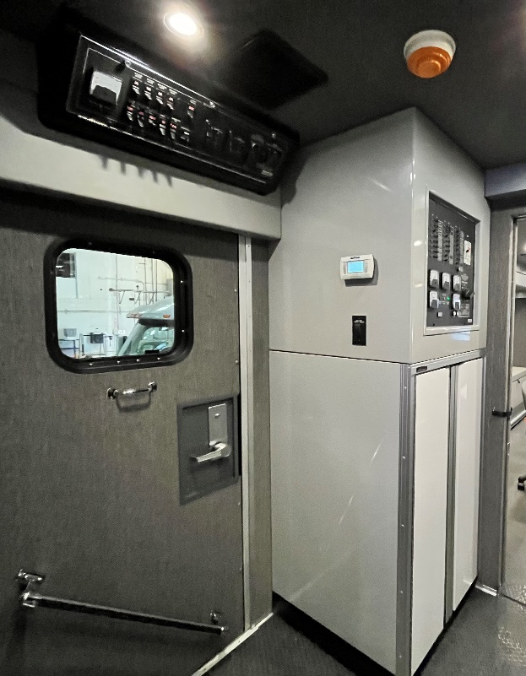
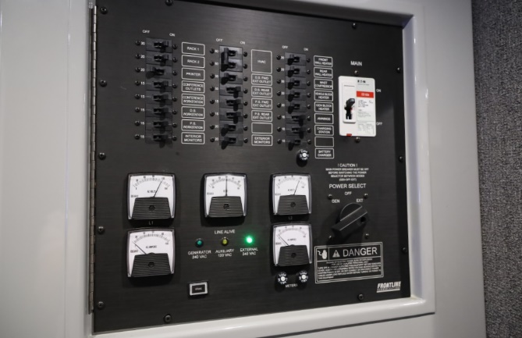
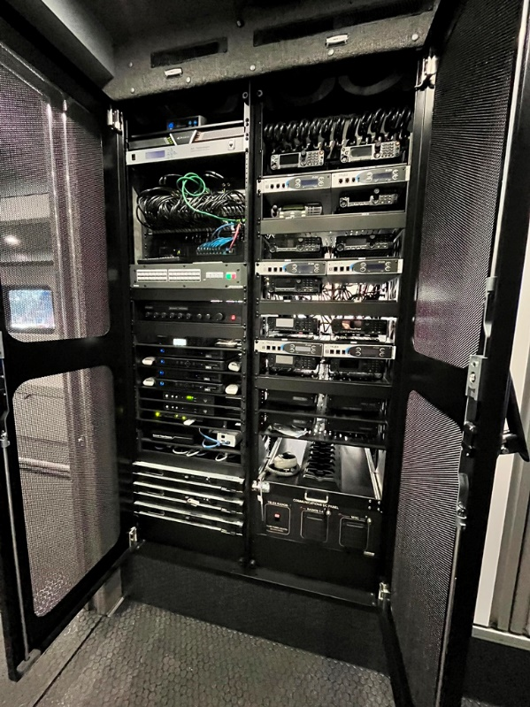
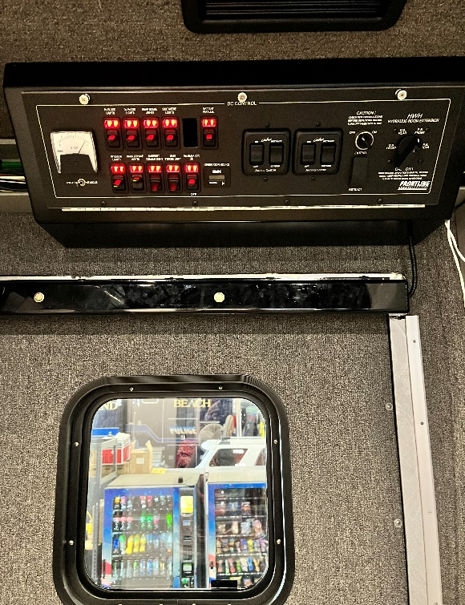
Equipment Racks & Power Panels
AC power panel with controls for equipment racks, workstations, HVAC system, mast compressor, battery chargers, and interior and exterior power outlets
Equipment rack with optional second rack and custom rack doors, and large C-Tech storage cabinet.
DC power panel and LED courtesy light located at main entrance for convenient deployment.
This panel features controls for exterior and interior lighting, awning, slide-outs, battery parallel system, and generator start/stop.
Racks contain the multi-modem cellular system, satellite antenna controller, interoperability package, DirecTV and local TV, video switcher, PA system, Telex radios, radio patch panel, and DC communications panel

Slide 8
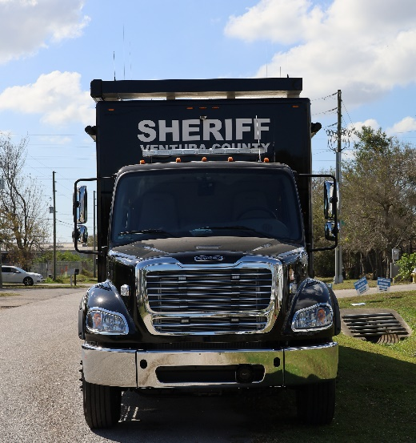
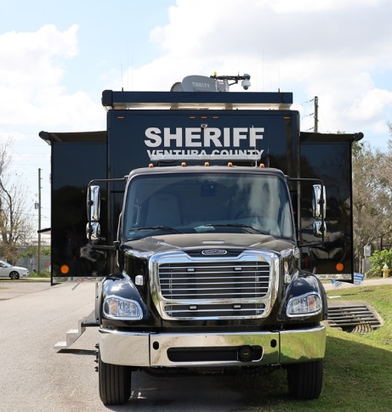
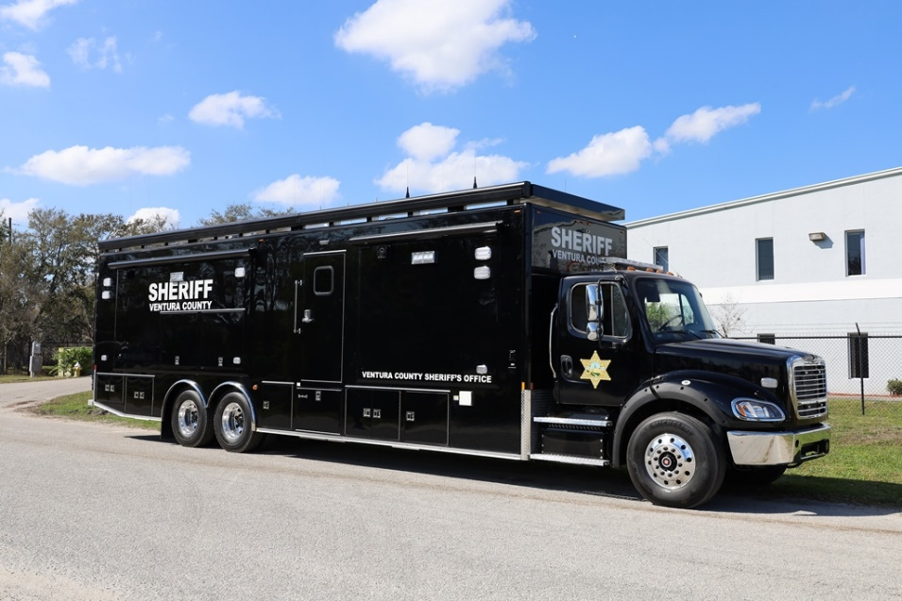
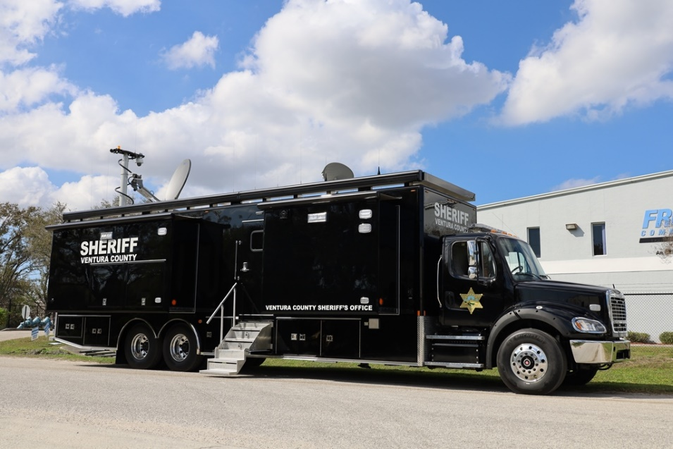
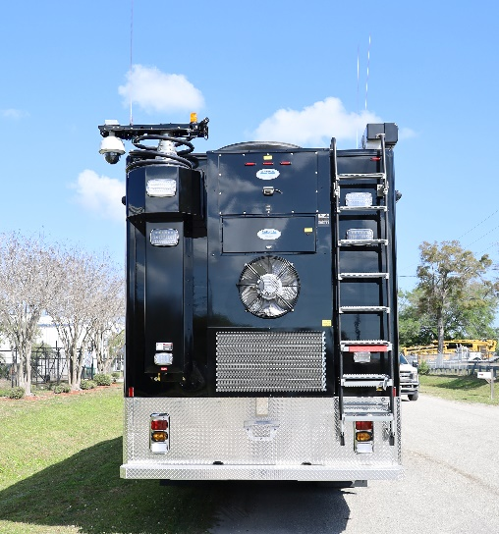
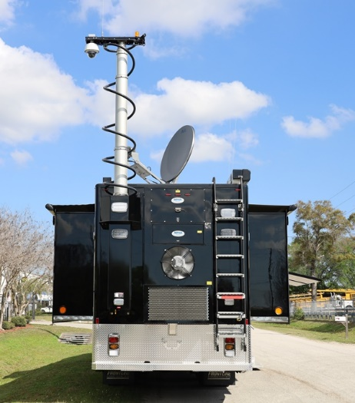
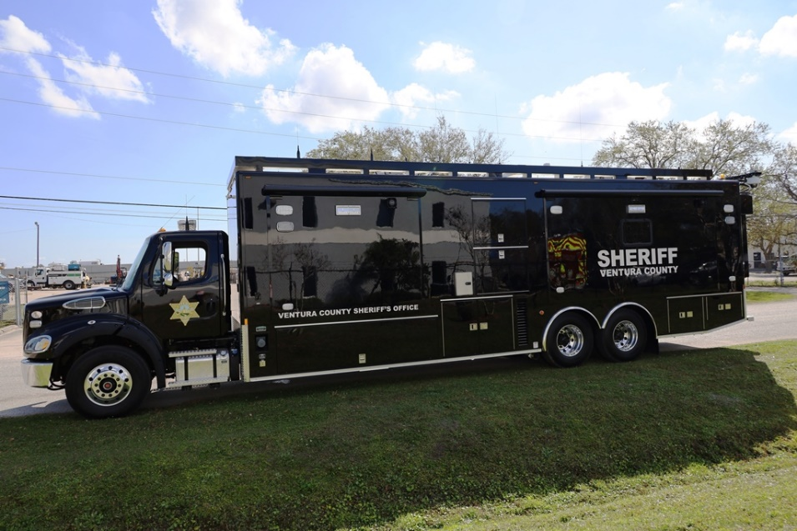
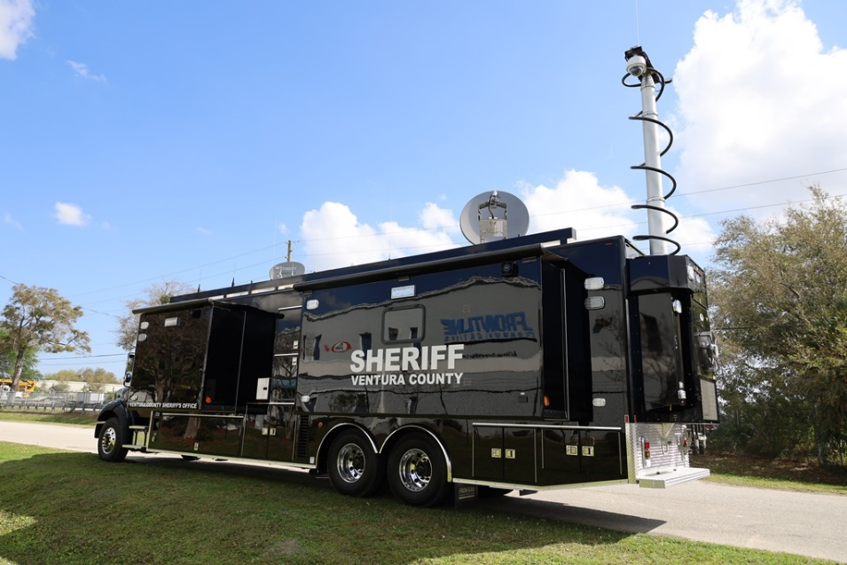
Additional Vehicle Photos
Transport Mode:
Deployed:

Slide 9
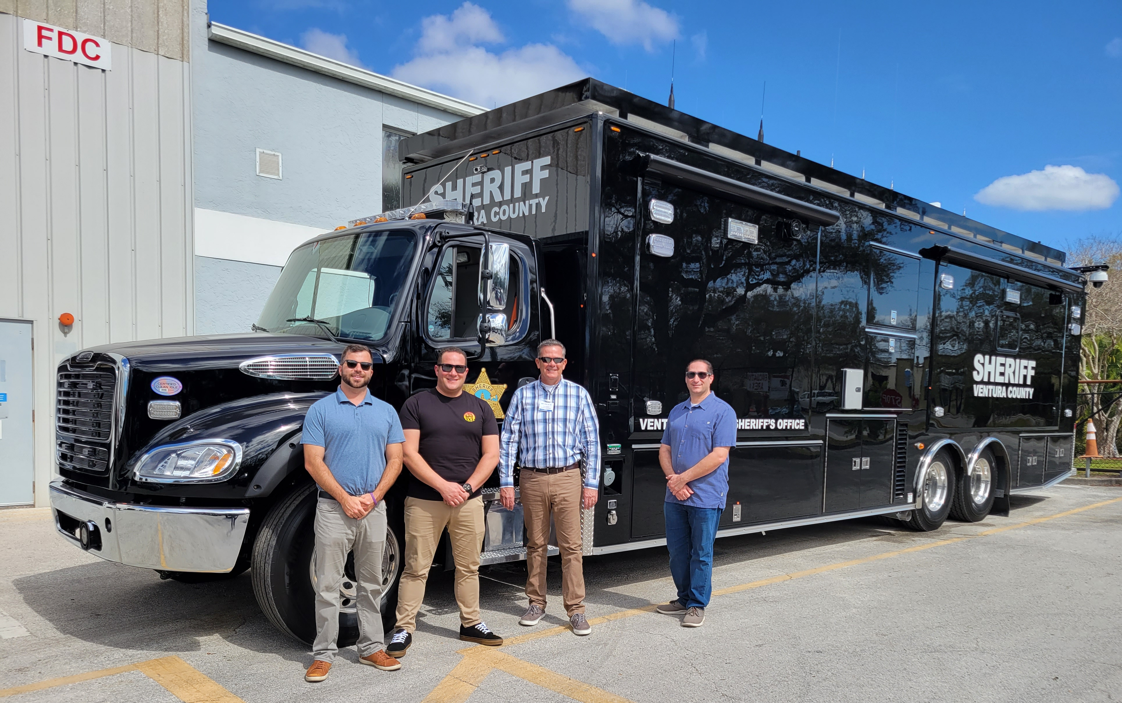


Thank you, South Coast Fire Equipment and Ventura County Sheriff’s Office for your business.

